Slide 1
MHRN1 Suicide Risk Prediction Project
4 MHRN health systems (GH, KPSC, KPCO, HealthPartners)
Approx. 1.2 million PHQ9 observations for 250k patients
Focus on prediction by response to PHQ9 item 9
Publications:
  Risk of suicide attempt and suicide death following completion of the Patient Health Questionnaire depression module in community practice. J Clin Psychiatry 2016; 77:221.
  Suicidal Ideation Reported on the PHQ9 and Risk of Suicidal Behavior across Age Groups. J Affect Disord (in press).
  Between-visit changes in suicidal ideation and risk of subsequent suicide attempt. Depress Anxiety (in press).
  Suicidal Ideation as Measured by the PHQ9 in Elderly or Medically Ill Patients. – revising for new submission
  Predicting Fatal and Non-fatal Suicide Attempt Among Adolescents Using Item 9 of the PHQ9. - resubmitted
  Positive Screening for Suicidal Ideation and Risk for Subsequent Suicide Attempt in Different Racial and Ethnic Groups. – submitted
  Prediction of suicidal behavior in primary care vs. MH specialty. – in process

Slide 2
Suicide Prevention Outreach Trial
Pragmatic trial of two population-based outreach programs (risk assessment/care mgmt, online DBT skills)
Recruitment underway at HealthPartners, KPCO, KPWA, and KPNW (joined in January)
Approximately 7500 enrolled (current rate of 200/week expected to decline to 150/week).
Lessons/challenges:
  Epic population management tools are powerful, but complicated
  Changing culture of IRBs and DSMBs is a heavy lift – but there is progress!
  Working with health systems has been quite smooth
  Will need to re-validate outcome measures after ICD10 transition

Slide 3
MHRN2 Suicide Risk Calculator Project
Settings
  7 health systems (Group Health, HealthPartners, Henry Ford, KP Colorado, KP Hawaii, KP Northwest, KP Southern California)
  8 million members
Visit Sample
  Age 13 or older
  Specialty MH visit OR primary care visit with MH diagnosis
Outcomes
  Encounter for self-inflicted injury/poisoning in 90days
  Death by self-inflicted injury/poisoning in 90 days

Slide 4
Suicide Risk Calculator Project: Predictors
Demographics (age, sex, race/ethnicity, neighborhood SES)
MH and SUD diagnoses (current, recent, last 5 yrs)
Psychiatric medication dispensings (current, recent, last 5 yrs)
Co-occurring medical conditions (per Charlson index)
PHQ item 9 scores (current, recent, ever)
PHQ8 scores (current, recent, ever)
  Approximately 160 indicators plus 40 selected interactions

Slide 5
Sample description:
19.6 million visits for approx. 2.9 million people
51% MH specialty and 48% primary care
Race/Ethnicity: 14% Hispanic, 9% African American, 5% Asian
Insurance source: 5% Medicaid, 20% Medicare
Diagnoses: 1.5 million Bipolar Disorder, 690K Schizophrenia/Psychosis
1.9 million have PHQ item 9 score recorded
24,000 visits followed by suicide death (2108 unique events)
440,000 visits followed by suicide attempt (29,423 unique events)

Slide 6
Modelling approach:
Variable Selection
  Logistic model with penalized LASSO selection
Estimation
  Logistic model accounting for within-person clustering
Confirmation
  Calculate performance characteristics on independent sample

Slide 7
Predicting suicide attempt in 90 days:
106 variables selected:
SUICIDE ATTEMPT FOLLOWING MENTAL HEALTH SPECIALTY VISIT | SUICIDE ATTEMPT FOLLOWING PRIMARY CARE VISIT
Depression diagnosis in last 5 yrs. | Depression diagnosis in last 5 yrs.
Suicide attempt in last 5 yrs. | Age 13-17 and female
Drug Abuse diagnosis in last 5 yrs. | Suicide attempt in last 5 yrs.
Age 13-17 and female | PHQ9 Item 9 score =3 in last year
Alcohol Abuse diag. in last 5 yrs | Alcohol Abuse diag. in last 5 yrs
PHQ9 Item 9 score =3 in last year | Age 65 or older
Suicide attempt in last 3 mos. | Mental health inpatient stay in last yr.
Suicide attempt in last year | Benzodiazepine Rx. in last 3 mos.
Personality disorder diag. in last 5 yrs. | Suicide attempt in last 3 mos.
Anxiety Disorder diag. in last 5 yrs. | Mental Health ER visit in last 3 mos.
Suicide attempt in last 5 years. | Personality disorder diag. in last 5 yrs.
Benzodiazepine Rx. in last 3 mos. | Eating Disorder diagnosis in last 5 yrs.
Insured via individual insurance plan | Suicide attempt in last year
Age 13-17 | Mental Health ER visit in last 3 mos.
Eating Disorder diagnosis in last 5 yrs. | Laceration suicide attempt last 5 yrs.
Mental Health ER visit in last 3 mos. | Suicide attempt in last 5 years.
PHQ9 Item 9 score=2 in last year | Any injury/poisoning diag. last 3 mos.
Mental health outpatient visit in last yr. | Antidepressant Rx last 3 mos.
Mental health inpatient stay in last yr. | Benzodiazepine Rx. last year.
Insured via Medicaid | Mental Health ER visit last 5 yrs.

Slide 8
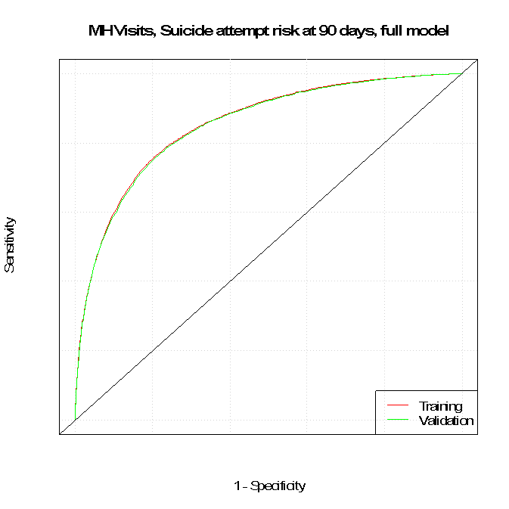
Predicting suicide attempt in 90 days (MH Specialty)
AUC=0.85

Slide 9
For comparison:
Prediction of suicidal behavior:
  Suicide death after medical hospitalization 0.74*
  Suicide death after OP visit (Army STARRS) 0.67
  Suicide death in VA service users 0.76*
  Suicide attempt/death in health system 0.77
Prediction of adverse medical events:
  High ER utilization 0.71
  Re-admission for CHF 0.62
  In-hospital mortality after sepsis 0.76
  Re-admission for CHF 0.78

Slide 10
Predicting attempt in 90 days: Item 9 vs. risk score
% of Visits | Predicted Risk | Actual Risk | % of All Attempts
>99th | >7.4% | 10.6% | 16%
95th to 99th | 2.2% to 7.4% | 4.2% | 27%
90th to 95th | 1.2% to 2.2% | 1.8% | 15%
75th to 90th | 0.5% to 1.2% | 0.8% | 21%
50th to 75th | 0.2% to 0.5% | 0.3% | 13%
<50th | <0.2% | 0.1% | 8%
% of Visits | Item 9 Score | Actual Risk | % of Attempts
3.5% | 3 | 2.3% | 24%
4.5% | 2 | 1.4% | 22%
16% | 1 | .72% | 24%
76% | 0 | .19% | 30%
57% missing Item 9 score:
Actual risk = .29%
47% of attempts in this group

Slide 11
Secondary/Subgroup Analyses:
Suicidal behavior in perinatal period
Risk model specific to adolescents
Significance of PHQ9 item 9 in psychotic disorders
Others…

Slide 12
Additional funding request planned:
Refresh and expand dataset
  Extend visit sample through 2016
  Increase proportion with PHQ9 data
  More detail regarding timing of prediction events
New modeling methods (CART, Random Forest)

